Slide 1
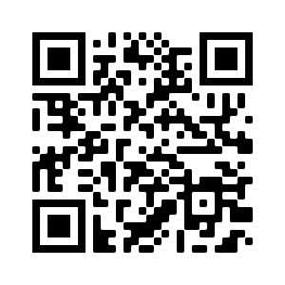
Taking the Specifications
Grading Plunge
Presented by Erica Knowles
Notes:
Welcome. For those of you who I haven’t had the pleasure of meeting yet, I am Erica Knowles – I teach psychology courses in the liberal arts department.
This fall semester I decided to try a different way of grading one of my courses (Abnormal Psychology): Why?
Unsatisfied with how much work I was doing grading the course in order to keep the “challenge” at an appropriate level
Grade complaints (a group of students that were very motivated but all wanted As without really understanding how/why they receive that grade)
Wanting to align my objectives with my assessments better – clarify that for students

Slide 2

Notes:
What does an A mean? What does C mean? To you? To your students?
Do you have course objectives? Do all you students meet these objectives? Do they know that?
Have you ever asked yourself while grading “does it matter?”

Slide 3
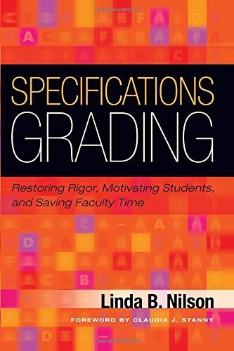
Notes:
I was unofficially introduced to specifications grading in 2015 at a conference for faculty development (my past work before Berklee) – the book had this bright red cover so I picked it up and read the back – it sounded pretty good. I kind of forgot about it until I was looking into some other grading options

Slide 4
What is Specifications Grading?
Alternative grading approach in which students’ work is graded on whether or not they meet “specifications”
Specifications
  Specified criteria that, if all areas satisfied, work is considered “satisfactory” or a “pass.”
Notes:
This idea isn’t necessarily new – there have been many iterations of standard-based grading:
contract grading

Slide 5
Nilson makes some big promises
Reduce faculty grading load (and stress)
Motivate student learning
Uphold high academic rigor
Incentivize students to take control of their own learning
Minimizing conflict between faculty and students
Providing positive directions for improvement and learning
Connect learning objectives to assessments and grade

Slide 6

How does Specifications Grading Work?
Assignments, tests, and other work are graded on a pass/fail basis.
      Think of the specs as a one-level rubric.

Slide 7
Examples from my course: Specs
An Online Assignment must meet the following criteria to be marked as Satisfactory.
Submitted on time
Answered all questions
Demonstrated sound academic effort (complete, minimal typos, attention to detail)

Slide 8
Examples from my course: Specs
Document submitted in correct format and included annotated bibliography.
Bibliography contained the 4 required articles; citations followed APA style, with some minor errors; annotations demonstrated sufficient comprehension; incorporated feedback given on previous versions.
Effectively generated a patient and incorporated symptoms into the patient background that accurately captures the DSM-5 diagnosis; showed moderate creativity in patient development and background
Discussed etiology of the disorder, either biological or psychological; supported discussion with peer-reviewed research; interpretation of research demonstrates sufficient level of understanding and comprehension
Discussed plausible treatments/interventions for patient; connection between patient background and etiology; supported discussion with peer-reviewed research; interpretation of research demonstrates sufficient level of understanding and comprehension
Organization of case study was adequate and reader can follow most points; contains minor errors in grammar, spelling, etc.
Notes:
Specs for final paper
*Satisfactory on first two criteria will confer B-level score if the remaining criteria are not satisfactorily met (for A-level score)

Slide 9
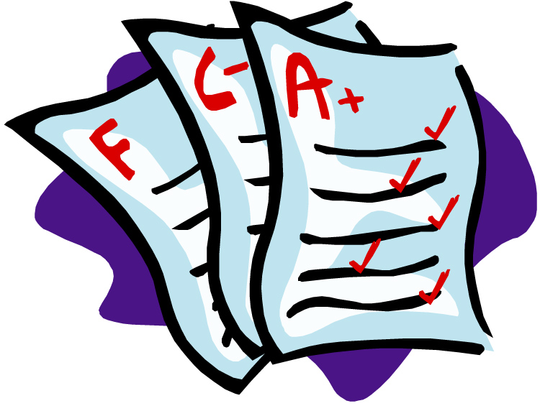
How does Specifications Grading work?
Create bundles of assignments
  Course grades are based on the bundles of assignments and tests that students complete at a satisfactory level.
Notes:
Tokens allow for flexibility:
Token #1 – Extra Absence
Token #2 – Extra Revision
Token #3 – Late Submission
Do not need to have a D-Bundle. Many specs grading-based courses do not.
For example: https://justtv.wordpress.com/2016/02/16/rethinking-grading-an-in-progress-experiment/
Grades of D will only be given in rare cases where a student meets most of the C Bundle requirements but falls short in one area—typically, a student who does not meet the requirements of the C Bundle will fail the course.

Slide 10
Examples from my course: Bundles
A Bundle: Students who complete the following will pass the course with a grade of A:
Actively attend all course meetings, with up to 2 absences, per the attendance policy below
Satisfactorily complete at least 9 case studies
Satisfactorily complete at least 11 “further your perspective” online assignments
Achieve an 8/10 on at least 13 in-class weekly quizzes
Satisfactorily complete at least two advanced-level questions on both the midterm and the final
Complete the A-level work for the final project

Slide 11
Examples from my course: Bundles
D Bundle: Students who complete the following will pass the course with a grade of D:
Actively attend all course meetings, with up to 7 absences, per the attendance policy below
Satisfactorily complete at least 5 case studies
Achieve a 7/10 on at least 7 in-class weekly quizzes
Satisfactorily complete at least one basic-level question on both the midterm and final
Notes:
Do not need to have a D-Bundle. Many specs grading-based courses do not.
For example: https://justtv.wordpress.com/2016/02/16/rethinking-grading-an-in-progress-experiment/
Grades of D will only be given in rare cases where a student meets most of the C Bundle requirements but falls short in one area—typically, a student who does not meet the requirements of the C Bundle will fail the course.

Slide 12

How does Specifications Grading Work?
Align assessments/bundles with course objectives.
  Completing a given bundle indicates that the student has achieved certain of those outcomes

Slide 13
Examples for my course
All students who pass the course (with a minimum grade of D) will have demonstrated the ability to:
Recognize or "diagnose" common psychological disorders
Students who achieve an average level of mastery (with a minimum grade of C) will have also demonstrated the ability to:
Discuss risk factors for the development of psychological disorders
Describe common explanations for the etiology of psychological disorders
Students who achieve a higher level of mastery (with a minimum grade of B) will have also demonstrated the ability to:
Determine effective treatments for specific psychological disorders
Evaluate the role of society on how we diagnose and treat mental illness
Students who achieve the highest level of mastery (with a grade of A) will have also demonstrated the ability to:
Formulate an original case study based on independent research

Slide 14

What worked well?
High level work
No late work
Less painful grading
Consistent final grade distribution

Slide 15
Comments from students: Good
“It was great to see everything for the semester laid out from the beginning and being able to keep notes on what you’ve done and what’s left to do.”
“It was really nice to be able to check your own progress in the course/visualize everything that we would be doing in the semester.”
“It was all highly organized, and the guidelines were laid out much clearer than any course I have ever taken at any academic level.”
“I understood what was expected of me and when I got my grades, and I understood why I received the grade I received.”

Slide 16
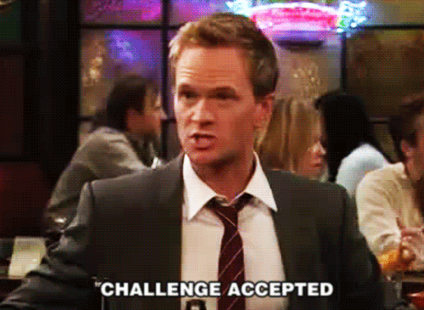
What posed a challenge?
Took students a bit to warm up to it
Calculating final grades
  Ended up using a point system (not my preferred solution but it worked)
  - All students started with 96 points
  - 3 points subtracted for every B-bundle item
  - 5 points subtracted for every C-bundle item
  - 7 points subtracted for every D-bundle item

Slide 17
Comments from students: Challenges
“I found it harder to get the grade I wanted because specifications grading seems stricter than regular grading criteria.”
“Trying to figure out my grade if I got A level grades in everything else but the case studies”
“There was zero room for error, so one mistake seemed to be the difference between an S and a U.”
“Ironically, I found it more stressful to be so aware of what my grade was in the course and I found myself obsessing over my grades more than usual.”
Notes:
In general, students suggestions to address the challenges was to have a place for partial credit – which is in direct opposition to the specifications grading approach

Slide 18

Interested?
Things to think about…
  What skills should students leave with? Clear objectives?
  Are you assessing student skills outline in objectives?
  Do you have clear expectations/criteria for student work?

Slide 19
Thank you!
https://bpmresearchlab.org/teaching/
Notes:
I will post the slides and some additional resources here for those that are interested in looking into specs grading more
Print copies of syllabus
Print copies of infographic syllabus, schedule, and checklist

